Slide 1
Relational Database Design
Normalization

Slide 2
Informal Design Guidelines for Relational Databases
What is relational database design?
The grouping of attributes to form "good" relation schemas
What are the criteria for "good" base relations?
  Semantics of the attributes
  Problems with update anomalies
  Null values in tuples
  Spurious tuples

Slide 3
Criteria for “good” relations
GUIDELINE 1 (semantics of attributes): Informally, each tuple in a relation should represent one entity or relationship instance. (Applies to individual relations and their attributes).
Attributes of different entities (EMPLOYEEs, DEPARTMENTs, PROJECTs) should not be mixed in the same relation
Only foreign keys should be used to refer to other entities
Entity and relationship attributes should be kept apart as much as possible.
Mixing attributes of multiple entities may cause problems
Information when stored redundantly waste storage

Slide 4
EXAMPLE OF AN UPDATE ANOMALY
Consider the relation:
EMP_PROJ ( Emp#, Proj#, Ename, Pname, No_hours)
Update Anomaly: Changing the name of project number P1 from “Billing” to “Customer-Accounting” may cause this update to be made for all 100 employees working on project P1.
Insert Anomaly: Cannot insert a project unless an employee is assigned to .
Inversely - Cannot insert an employee unless he/she is assigned to a project.
Delete Anomaly: When a project is deleted, it will result in deleting all the employees who work on that project. Alternately, if an employee is the sole employee on a project, deleting that employee would result in deleting the corresponding project.

Slide 5
Problems with update anomalies
GUIDELINE 2 (update anomalies): Design a schema that does not suffer from the insertion, deletion and update anomalies. If there are any present, then note them so that applications can be made to take them into account
GUIDELINE 3 (Null values): Relations should be designed such that their tuples will have as few NULL values as possible
Attributes that are NULL frequently could be placed in separate relations (with the primary key)
Reasons for nulls:
  attribute not applicable or invalid
  attribute value unknown (may exist)
  value known to exist, but unavailable

Slide 6
Spurious Tuples
Bad designs for a relational database may result in erroneous results for certain JOIN operations
The "lossless join" property is used to guarantee meaningful results for join operations
GUIDELINE 4: The relations should be designed to satisfy the lossless join condition. No spurious tuples should be generated by doing a natural-join of any relations.
There are two important properties of decompositions:
non-additive or losslessness of the corresponding join
preservation of the functional dependencies.
Note that property (a) is extremely important and cannot be sacrificed. Property (b) is less stringent and may be sacrificed.

Slide 7
Banking Schema
branch (branch_name, branch_city, assets)
customer (customer_name, customer_street, customer_city)
account (account_number, branch_name, balance)
loan (loan_number, branch_name, amount)
depositor (customer_name, account_number)
borrower (customer_name, loan_number)

Slide 8
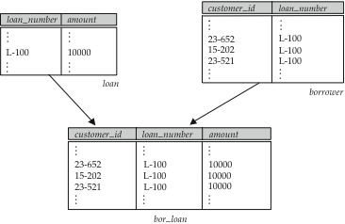
Combine Schemas?
Suppose we combine borrower and loan to get
  bor_loan = (customer_id, loan_number, amount )
Result is possible repetition of information (L-100 in example below)

Slide 9
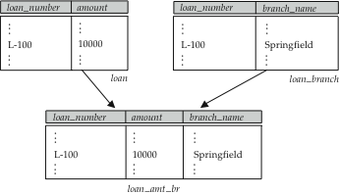
A Combined Schema Without Repetition
Consider combining loan_branch and loan
  loan_amt_br = (loan_number, amount, branch_name)
No repetition (as suggested by example below)

Slide 10
Overall Database Design Process
We have assumed schema R is given
  R could have been generated when converting E-R diagram to a set of tables.
  R could have been a single relation containing all attributes that are of interest (called universal relation).
  Normalization breaks R into smaller relations.
  R could have been the result of some ad hoc design of relations, which we then test/convert to normal form.

Slide 11
ER Model and Normalization
When an E-R diagram is carefully designed, identifying all entities correctly, the tables generated from the E-R diagram should not need further normalization.
However, in a real (imperfect) design, there can be functional dependencies from non-key attributes of an entity to other attributes of the entity
  Example: an employee entity with attributes department_number and department_address, and a functional dependency department_number → department_address
  Good design would have made department an entity
Functional dependencies from non-key attributes of a relationship set possible, but rare --- most relationships are binary

Slide 12
What About Smaller Schemas?
Suppose we had started with bor_loan. How would we know to split up (decompose) it into borrower and loan?
In bor_loan, because loan_number is not a candidate key, the amount of a loan may have to be repeated. This indicates the need to decompose bor_loan.

Slide 13
What About Smaller Schemas?
Not all decompositions are good.
Suppose we decompose employee (employee_id, employee_name, telephone_number, start_date) into
employee1 = (employee_id, employee_name)
employee2 = (employee_name, telephone_number, start_date)
The next slide shows how we lose information -- we cannot reconstruct the original employee relation -- and so, this is a lossy decomposition.

Slide 14
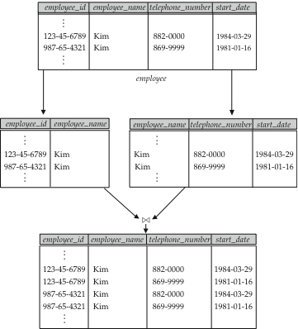
A Lossy Decomposition

Slide 15
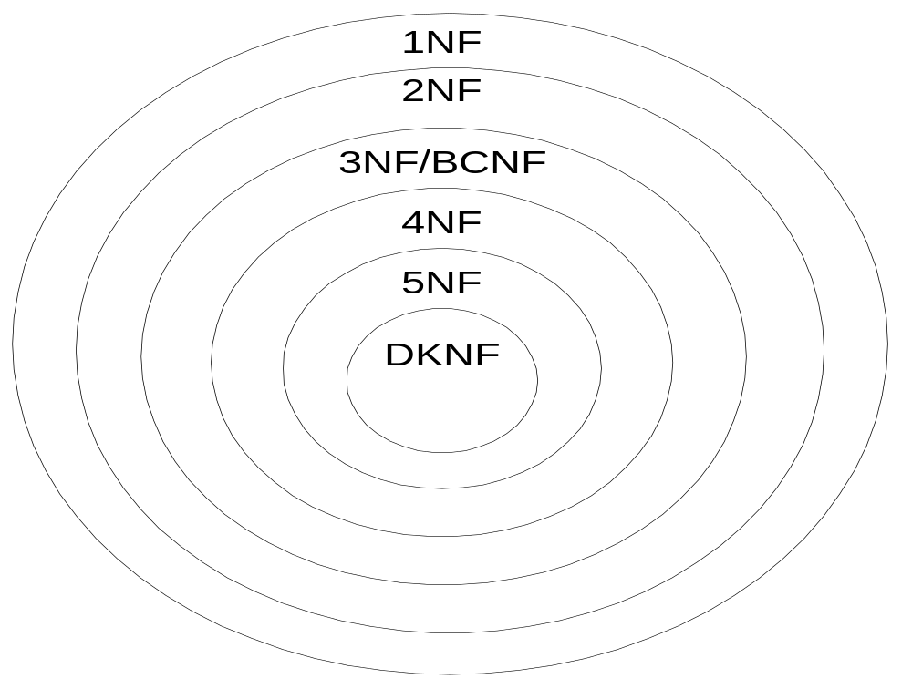
Relationships of Normal Forms
Notes:
1NF: least restrictive; every table in 1NF
2NF: more restrictive than 1NF; every table in 2NF is also in 1NF
3NF/BCNF: BCNF is a revised definition of 3NF; BCNF is more restrictive than 3NF
4NF: Inappropriate usage of an M-way relationship; Relationship independence and MVDs; does not involve FDs
5NF: does not involve FDs; Inappropriate usage of an M-way relationship; more specialized than 4NF
DKNF: ideal rather than a practical normal form

Slide 16
Normalization
Un normalized
Relation
Remove
repeating groups
Normalized
Relation (1NF)
Remove partial
dependencies
2 NF
Remove transitive
dependencies
3 NF
Remove remaining
Anomalies resulting
from FD‘s
Boyce/Codd NF
Remove other
dependencies

Slide 17
First Normal Form
Domain is atomic if its elements are considered to be indivisible units
  Examples of non-atomic domains:
    Set of names, composite attributes
    Identification numbers like CS101 that can be broken up into parts
A relational schema R is in first normal form if the domains of all attributes of R are atomic
Non-atomic values: complicated storage and encourage redundant (repeated) storage of data
We assume all relations are in first normal form

Slide 18
First Normal Form (Cont’d)
Atomicity is actually a property of how the elements of the domain are used.
  Example: Strings would normally be considered indivisible
  Suppose that students are given roll numbers which are strings of the form CS0012 or EE1127
  If the first two characters are extracted to find the department, the domain of roll numbers is not atomic.

Slide 19
Functional Dependencies
Normalization theory is based on the concepts of normal forms.
A relational table is said to be a particular normal form if it satisfied a certain set of constraints.
FDs and keys are used to define normal forms for relations
A set of attributes X functionally determines a set of attributes Y if the value of X determine a unique value for Y
X -> Y holds if whenever two tuples have the same value for X, they must have the same value for Y
For any two tuples t1 and t2 in any relation instance r(R): If t1[X]=t2[X], then t1[Y]=t2[Y]
X -> Y in R specifies a constraint on all relation instances r(R)
FDs are derived from the real-world constraints on the attributes

Slide 20
Examples of FD constraints
social security number determines employee name SSN -> ENAME
project number determines project name and location
PNUMBER -> {PNAME, PLOCATION}
employee ssn and project number determines the hours per week that the employee works on the project
{SSN, PNUMBER} -> HOURS
Example: Consider r(A,B ) with the following instance of r.
On this instance, A → B does NOT hold, but B → A does hold.
4
1 5
3 7

Slide 21
Examples of FD constraints
An FD is a property of the attributes in the schema R
The constraint must hold on every relation instance r(R)
If K is a key of R, then K functionally determines all attributes in R (since we never have two distinct tuples with t1[K]=t2[K])
K is a superkey for relation schema R if and only if K → R
K is a candidate key for R if and only if
  K → R, and
  for no α ⊂ K, α → R
Consider the schema:
bor_loan = (customer_id, loan_number, amount ).
We expect this functional dependency to hold:
loan_number → amount
but would not expect the following to hold:
amount → customer_name

Slide 22
Functional Dependencies (Cont.)
A functional dependency is trivial if it is satisfied by all instances of a relation
  Example:
    customer_name, loan_number → customer_name
    customer_name → customer_name
  In general, α → β is trivial if β ⊆ α

Slide 23
Inference Rules for FDs
Given a set of FDs F, we can infer additional FDs that hold whenever the FDs in F hold
Armstrong's inference rules:
IR1. (Reflexive) If Y subset-of X, then X -> Y
IR2. (Augmentation) If X -> Y, then XZ -> YZ
(Notation: XZ stands for X U Z)
IR3. (Transitive) If X -> Y and Y -> Z, then X -> Z
These rules are
  sound (generate only functional dependencies that actually hold) and
  complete (generate all functional dependencies that hold).

Slide 24
Inference Rules for FDs
Some additional inference rules that are useful:
(Decomposition) If X -> YZ, then X -> Y and X -> Z
(Union) If X -> Y and X -> Z, then X -> YZ
(Psuedotransitivity) If X -> Y and WY -> Z, then WX -> Z
The last three inference rules, as well as any other inference rules, can be deduced from IR1, IR2, and IR3 (completeness property)

Slide 25
Inference Rules for FDs
Closure of a set F of FDs is the set F⁺ of all FDs that can be inferred from F
F⁺ is a superset of F.
Closure of a set of attributes X with respect to F is the set X ⁺ of all attributes that are functionally determined by X
X ⁺ can be calculated by repeatedly applying IR1, IR2, IR3 using the FDs in F

Slide 26
Example of F+
R = (A, B, C, G, H, I)
F = { A → B
A → C
CG → H
CG → I
B → H}
some members of F⁺
  A → H
    by transitivity from A → B and B → H
  AG → I
    by augmenting A → C with G, to get AG → CG
    and then transitivity with CG → I
  CG → HI
    by augmenting CG → I to infer CG → CGI,
    and augmenting of CG → H to infer CGI → HI,
    and then transitivity

Slide 27
Procedure for Computing F⁺
To compute the closure of a set of functional dependencies F:
F ⁺ = F
repeat
for each functional dependency f in F⁺
apply reflexivity and augmentation rules on f
add the resulting functional dependencies to F ⁺
for each pair of functional dependencies f₁and f₂ in F ⁺
if f₁ and f₂ can be combined using transitivity
then add the resulting functional dependency to F ⁺
until F ⁺ does not change any further
NOTE: We shall see an alternative procedure for this task later

Slide 28
Closure of Functional Dependencies (Cont.)
We can further simplify manual computation of F⁺ by using the following additional rules.
  If α → β holds and α → γ holds, then α → β γ holds (union)
  If α → β γ holds, then α → β holds and α → γ holds (decomposition)
  If α → β holds and γ β → δ holds, then α γ → δ holds (pseudotransitivity)

Slide 29
Second Normal Form (2NF)
Uses the concepts of FDs, primary key
Definitions:
Prime attribute - attribute that is member of the primary key K
Full functional dependency - a FD Y -> Z where removal of any attribute from Y means the FD does not hold any more
Examples: - {SSN, PNUMBER} -> HOURS is a full FD since neither SSN -> HOURS nor PNUMBER -> HOURS hold
- {SSN, PNUMBER} -> ENAME is not a full FD (it is called a partial dependency ) since SSN -> ENAME also holds

Slide 30
Second Normal Form (2NF)
A relation schema R is in second normal form (2NF) if every non-prime attribute A in R is fully functionally dependent on the primary key
R can be decomposed into 2NF relations via the process of 2NF normalization

Slide 31
Normalization
An Example : A company obtains parts from a number of suppliers. Each supplier is located in one city. A city can have more than one supplier located there and each city has a status code associated with it. Each supplier may provide many parts.
The company creates a simple relational table to store this information:
FIRST (s#, status, city, p#, qty)
s# Supplier identification number
status Status code assigned to city
City City where supplier is located
p# Part number of part supplied
Qty Qty of parts supplied to date
Composite primary key is (s#, p#)

Slide 32
Normalization
FIRST NORMAL FORM –1NF
s# | city | status | p# | qty
s1 | London | 20 | p1 | 300
s1 | London | 20 | p2 | 100
s1 | London | 20 | p3 | 200
s1 | London | 20 | p4 | 100
s2 | Paris | 10 | p1 | 250
s2 | Paris | 10 | p3 | 100
s3 | Tokyo | 30 | p2 | 300
s3 | Tokyo | 30 | p4 | 200

Slide 33
Normalization
SECOND NORMAL FORM – 2NF
FIRST is in 1NF but not in 2NF because status and city are functionally dependent upon only on the column s# of the composite key (s#, p#).
PARTS
s# | p# | qty
s1 | p1 | 300
s1 | p2 | 100
s1 | p3 | 200
s1 | p4 | 100
s2 | p1 | 250
s2 | p3 | 100
s3 | p2 | 300
s3 | p4 | 200
SECOND
s# | city | status
s1 | London | 20
s2 | Paris | 10
s3 | Tokyo | 30

Slide 34
Goals of Normalization
Let R be a relation scheme with a set F of functional dependencies.
Decide whether a relation scheme R is in “good” form.
In the case that a relation scheme R is not in “good” form, decompose it into a set of relation scheme {R₁, R₂, ..., R_{n}} such that
  each relation scheme is in good form
  the decomposition is a lossless-join decomposition
  Preferably, the decomposition should be dependency preserving.

Slide 35
Lossless-join Decomposition
For the case of R = (R₁, R₂), we require that for all possible relations r on schema R
r = ∏_{R1} (r ) ∏_{R2} (r )
A decomposition of R into R₁ and R₂ is lossless join if and only if at least one of the following dependencies is in F⁺:
  R₁ ∩ R₂ → R₁
  R₁ ∩ R₂ → R₂

Slide 36
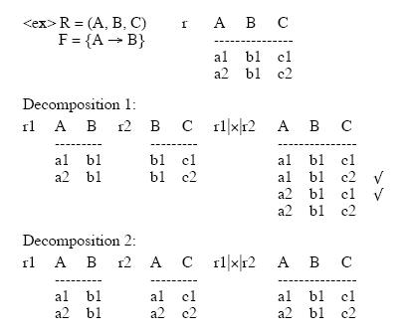
Example of Relation Decomposition

Slide 37
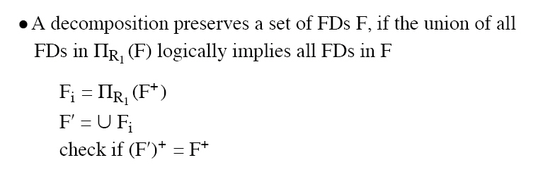
Dependency Preservation Decomposition
Definition: Each FD specified in F either appears directly in one of the relations in the decomposition, or be inferred from FDs that appear in some relation.

Slide 38
Dependency Preserving Example
Consider relation ABCD, with FD’s :
A ->B, B ->C, C ->D
Decompose into two relations: ABC and CD.
ABC supports the FD’s A->B, B->C.
CD supports the FD C->D.
All the original dependencies are preserved.

Slide 39
Boyce-Codd Normal Form
A relation schema R is in BCNF with respect to a set F of functional dependencies if for all functional dependencies in F⁺ of the form
α → β
where α ⊆ R and β ⊆ R, at least one of the following holds:
α  → β is trivial (i.e., β ⊆ α)
α is a superkey for R
Example schema not in BCNF:
bor_loan = ( customer_id, loan_number, amount )
because loan_number → amount holds on bor_loan but loan_number is not a superkey

Slide 40
Decomposing a Schema into BCNF
Suppose we have a schema R and a non-trivial dependency α →β causes a violation of BCNF.
We decompose R into:
  (α U β )
  ( R - ( β - α ) )
In our example,
  α = loan_number
  β = amount
  and bor_loan is replaced by
  (α U β ) = ( loan_number, amount )
  ( R - ( β - α ) ) = ( customer_id, loan_number )

Slide 41
BCNF and Dependency Preservation
Constraints, including functional dependencies, are costly to check in practice unless they relate to only one relation
If it is sufficient to test only those dependencies on each individual relation of a decomposition in order to ensure that all functional dependencies hold, then that decomposition is dependency preserving.
Because it is not always possible to achieve both BCNF and dependency preservation, we consider a weaker normal form, known as third normal form.

Slide 42
Third Normal Form: Motivation
There are some situations where
  BCNF is not dependency preserving, and
  efficient checking for FD violation on updates is important
Solution: define a weaker normal form, called Third Normal Form (3NF)
  Allows some redundancy (with resultant problems; we will see examples later)
  But functional dependencies can be checked on individual relations without computing a join.
  There is always a lossless-join, dependency-preserving decomposition into 3NF.

Slide 43
Third Normal Form
A relation schema R is in third normal form (3NF) if for all:
α → β in F⁺
at least one of the following holds:
  α → β is trivial (i.e., β ∈ α)
  α is a superkey for R
  Each attribute A in β – α is contained in a candidate key for R.
  (NOTE: each attribute may be in a different candidate key)
If a relation is in BCNF it is in 3NF (since in BCNF one of the first two conditions above must hold).
Third condition is a minimal relaxation of BCNF to ensure dependency preservation (will see why later).

Slide 44
Normalization
THIRD NORMAL FORM – 3NF
A relational table is in third normal form (3NF) if it is already in 2NF and every non-key column is non transitively dependent upon its primary key.
In other words, all non-key attributes are functionally dependent only upon the primary key.
SUPPLIER
s# | city | status
s1 | London | 20
s2 | Paris | 10
s3 | Tokyo | 30
s4 | Paris | 10
The table supplier is in 2NF but not in 3NF because it contains a transitive dependency
SUPPLIER.s# —> SUPPLIER.city
SUPPLIER.city —> SUPPLIER.status
SUPPLIER.s# —> SUPPLIER.status

Slide 45
Normalization
CITY_STATUS
SUPPLIER
city | status
London | 20
Paris | 10
Tokyo | 30
Rome | 50
s# | city
s1 | London
s2 | Paris
s3 | Tokyo
s4 | Paris
s5 | London
The transformation of SUPPLIER into 3NF

Slide 46
Comparison of BCNF and 3NF
It is always possible to decompose a relation into a set of relations that are in 3NF such that:
  the decomposition is lossless
  the dependencies are preserved
It is always possible to decompose a relation into a set of relations that are in BCNF such that:
  the decomposition is lossless
  it may not be possible to preserve dependencies.

Slide 47
BCNF and Dependency Preservation
Constraints, including functional dependencies, are costly to check in practice unless they relate to only one relation
If it is sufficient to test only those dependencies on each individual relation of a decomposition in order to ensure that all functional dependencies hold, then that decomposition is dependency preserving.
Because it is not always possible to achieve both BCNF and dependency preservation, we consider a weaker normal form, known as third normal form.

Slide 48
How good is BCNF?
There are database schemas in BCNF that do not seem to be sufficiently normalized
Consider a database
classes (course, teacher, book )
such that (c, t, b) ∈ classes means that t is qualified to teach c, and b is a required textbook for c
The database is supposed to list for each course the set of teachers any one of which can be the course’s instructor, and the set of books, all of which are required for the course (no matter who teaches it).

Slide 49
How good is BCNF? (Cont.)
course
teacher
book
database
database
database
database
database
database
operating systems
operating systems
operating systems
operating systems
Avi
Avi
Hank
Hank
Sudarshan
Sudarshan
Avi
Avi
Pete
Pete
DB Concepts
Ullman
DB Concepts
Ullman
DB Concepts
Ullman
OS Concepts
Stallings
OS Concepts
Stallings
classes
There are no non-trivial functional dependencies and therefore the relation is in BCNF
Insertion anomalies – i.e., if Marilyn is a new teacher that can teach database, two tuples need to be inserted
(database, Marilyn, DB Concepts)
(database, Marilyn, Ullman)

Slide 50
How good is BCNF? (Cont.)
Therefore, it is better to decompose classes into:
course
teacher
database
database
database
operating systems
operating systems
Avi
Hank
Sudarshan
Avi
Jim
teaches
course
book
database
database
operating systems
operating systems
DB Concepts
Ullman
OS Concepts
Shaw
text
This suggests the need for higher normal forms, such as Fourth Normal Form (4NF), which we shall see later.

Slide 51
Fourth Normal Form
A relation schema R is in 4NF if and only if, whenever there exist subsets A and B of the attributes of R such that the MVD A →→ B is satisfied then all attributes of R are also functionally dependent on A.
If a relation is in 4NF it is in BCNF and all MVDs in R are in fact FDs out of the candidate key.

Slide 52
Multi Valued Dependency & 4NF
ENAME | PNAME | DNAME
Smith | X | Research
Smith | Y | Sales
Smith | X | Sales
Smith | Y | Research
ENAME | PNAME
Smith | X
Smith | Y
ENAME | DNAME
Smith | Research
Smith | Sales

Slide 53
Further Normal Forms
  The advanced forms of normalization are:
    Fourth Normal Form (4NF)
    Fifth Normal Form (5NF or PJNF)
    Domain-key Normal Form (DKNF)
Join dependencies generalize multivalued dependencies
  lead to project-join normal form (PJ/NF) (also called fifth normal form)
A class of even more general constraints, leads to a normal form called domain-key normal form.
Problem with these generalized constraints: are hard to reason with, and no set of sound and complete set of inference rules exists.
Hence rarely used

Slide 54
Multivalued Dependencies (MVDs)
Let R be a relation schema and let α ⊆ R and β ⊆ R. The multivalued dependency
α →→ β
holds on R if in any legal relation r(R), for all pairs of tuples t₁ and t₂ in r such that t₁[α] = t₂ [α], there exist tuples t₃ and t₄ in r such that:
t₁[α] = t₂ [α] = t₃ [α] = t₄ [α]
t₃[β] = t₁ [β]
t₃[R – β] = t₂[R – β]
t₄ [β] = t₂[β]
t₄[R – β] = t₁[R – β]

Slide 55
Join Dependency
A join dependency (JD), denoted by JD(R1,R2, … Rn), specified on relation schema R, specifies a constraint on the states r of R.
Natural join (R1(r),R2(r), … Rn(r)) = r
Join dependency, multiway decomposition, results the fifth normal form (5NF)

Slide 56
5NF
A MVD is a special case of a JD with n=2.
JD(R1,R2) ➔ MVD(R1 ∩ R2) ->> R1 – R2
MVD(R1 ∩ R2) ->> R2 – R1
A JD is trivial if any of Ri is R.
The 5NF is also called project-join normal form (PJNF).

Slide 57
Join Dependency & 5NF
5NF: A relation schema is in 5NF or project-join normal form(PJNF) w.r.t a set of F of functional, multivalued and join dependencies if, for every join dependency JD(R1,R2, … , Rn) in closure of F, every Ri is a super key of R.

Slide 58
Join Dependency & 5NF
SNAME | PARTNAME | PROJNAME
Smith | Bolt | ProjX
Smith | Nut | ProjY
Brown | Bolt | ProjY
John | Nut | ProjZ
Brown | Nail | ProjX
There is no MVD ➔ 4NF; JD ( {SNAME PARTNAME} {PARTNAME PROJNAME} {SNAME PROJNAME} ) is not lossless➔ no 5NF

Slide 59
Join Dependency & 5NF
SNAME | PARTNAME | PROJNAME
Smith | Bolt | ProjX
Smith | Nut | ProjY
Brown | Bolt | ProjY
John | Nut | ProjZ
Assume additional constraint: whenever a supplier s supplies p, a project j uses p and s supplies at least one part to j, then the supplier s will also be supplying p to j.
Brown | Nail | ProjX
Smith ➔{Bolt, Nut}
Smith → ProjX → {Bolt}
Smith ➔{ProjX, ProjY}
Smith → ProjY → {Nut, Bolt}
ProjX ➔ {Bolt, Nail}
ProjY ➔ {Nut, Bolt}

Slide 60
Join Dependency & 5NF
SNAME | PARTNAME | PROJNAME
Smith | Bolt | ProjX
Smith | Nut | ProjY
Brown | Bolt | ProjY
John | Nut | ProjZ
Brown | Nail | ProjX
Smith | Bolt | ProjY
Brown | Bolt | ProjX
JD ( R1 = {SNAME PARTNAME} R2 = {PARTNAME PROJNAME} R3 = {SNAME PROJNAME} ) is valid ➔ each in 5NF

Slide 61
Inclusion Dependencies
To define certain inter-relation constraints.
  FK (referential integrity) cannot be specified as the functional or multivalued dependency
  The inclusion dependency R.X < S.Y between
    The set of attributes X of R and the set of attributes Y of S
    Specifies that at any specific time π_{X}(r(R)) ⊆ π_{Y}(s(S))
    Must have same number of attributes.
    Domain for each pair of corresponding attributes should be compatible.

Slide 62
Example
Department.dmgrssn <Employee.ssn
Employee.dnumber < department.dnumber
All the above represents the referential integrity constraints.
Employee.ssn < Person.ssn [specialization]

Slide 63
Domain-Key Normal Form (DKNF)
DKNF (the ultimate normal form, theoretically)
A relation R is said to be in DKNF if all constraints and dependencies that should hold on the relation can be enforced simple by enforcing the domain constraints and key constraints on the relation.
E.g., car(name, vn#), manufacture(vn#, country)
If car id Toyota or Lexus and the manufacturer country is Japan, then first character is “J”, etc…
Value…, ….

